Slide 1

Tips & Tricks for Mastering Microsoft Fabric Data Warehousing
Kristyna Ferris
Please grab some swag!

Slide 2





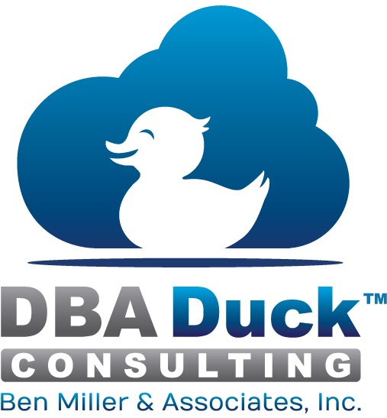











SQL Saturday Baton Rouge 2025
Thank you, Sponsors!

Slide 3

About Me ~ Kristyna Ferris
Microsoft MVP, Data Platform & Fabric Solution Architect, P3 Adaptive Lexington Data Tech Group co-organizer Co-author on DataOnWheels
Blog - https://dataonwheels.wordpress.com/ LinkedIn - https://www.linkedin.com/in/kristyna-ferris-dataonwheels/
Twitter & Bluesky - @data_dragoness

Slide 4
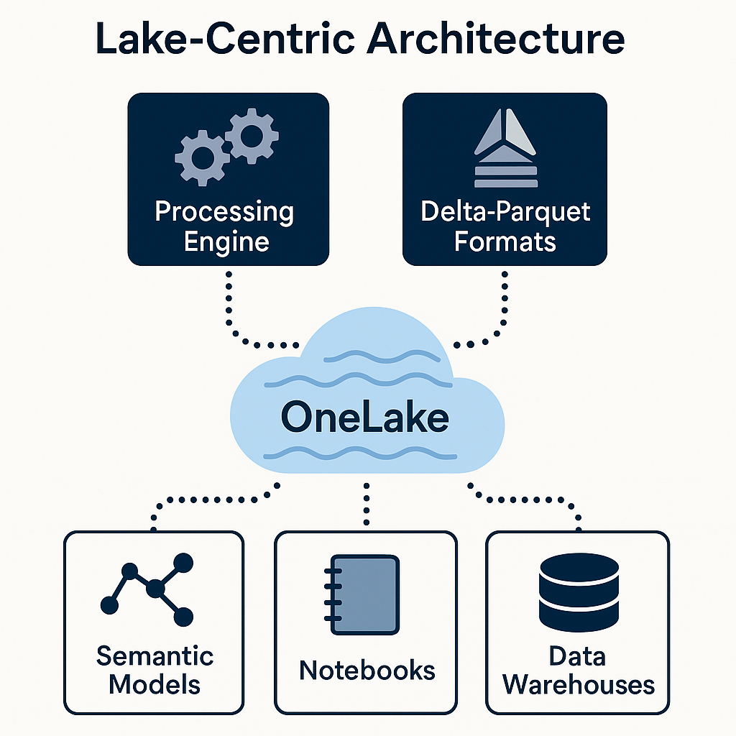
What is a Fabric Data Warehouse?
Lake-Centric Architecture
Built on a distributed processing engine within OneLake
Supports open Delta-Parquet formats which enables ACID transactions and seamless interoperability across Fabric workloads
Notes:
ACID =

Slide 5
What is a Fabric Data Warehouse?
ACID ?
Atomicity - transactions must complete fully or not at all.
Consistency – database is in a valid state before & after transaction. If a transaction violates integrity rules, it is not committed.
Isolation – concurrent transactions do not interfere with each other.
Durability – once a transaction is committed, its effects are permanent and saved to a non-volatile storage.
Notes:
ACID =

Slide 6
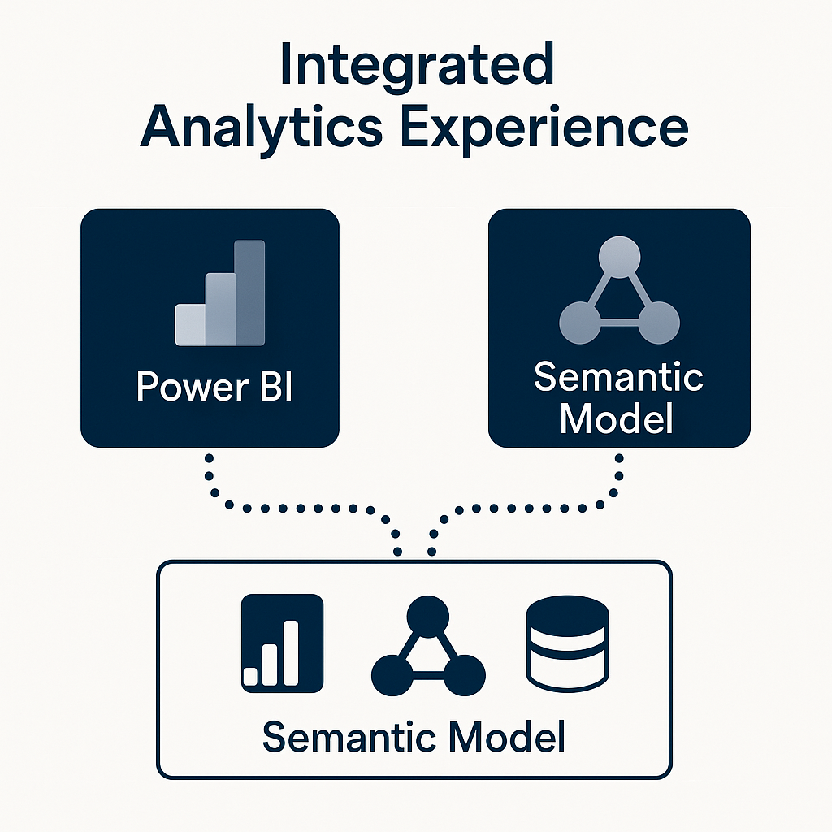
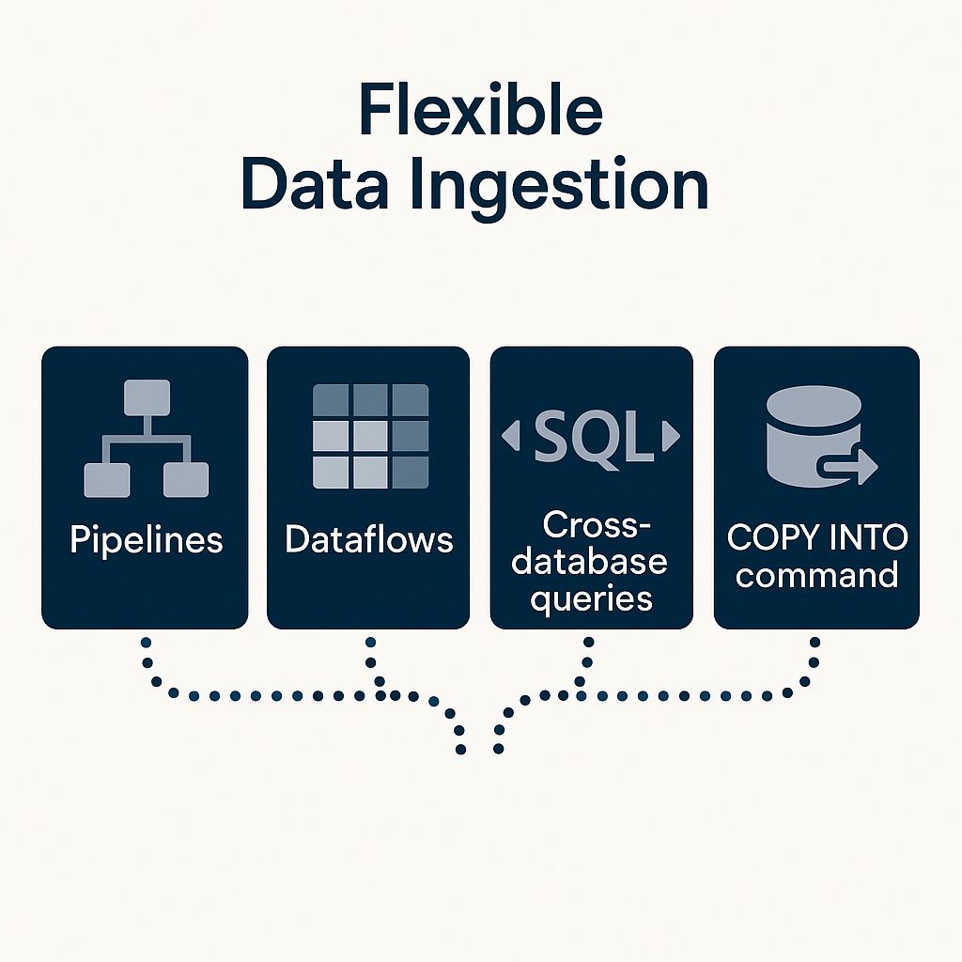
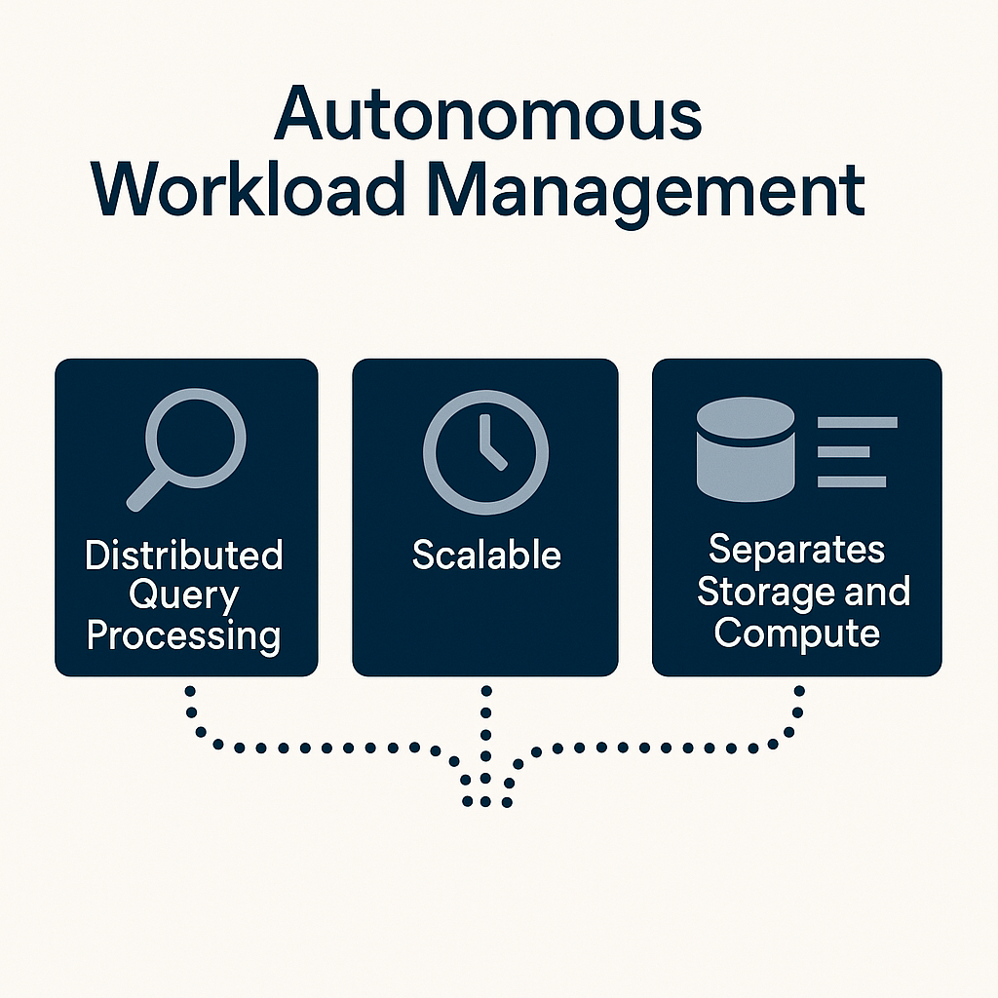
What is a Fabric Data Warehouse?

Slide 7
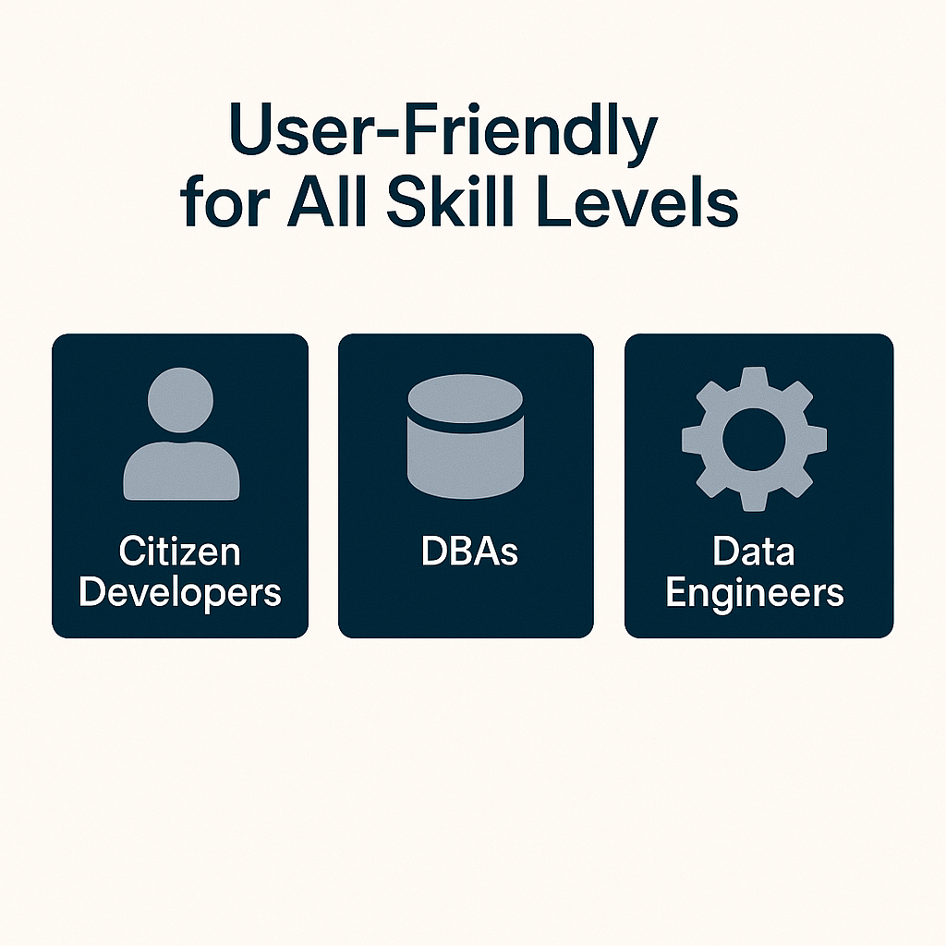
What is a Fabric Data Warehouse?
User-Friendly for All Skill Levels
The Big Selling Point
Designed for a range of users—from citizen developers to DBAs and data engineers—providing an easy-to-use SaaS experience that simplifies data warehousing tasks while offering elements of a deeper customization for more experienced users.

Slide 8

Sounds wonderful so…What’s the Issue?

Slide 9

The Issues
Case Sensitivity
Performance Monitoring
Killing Capacity Murderers

Slide 10
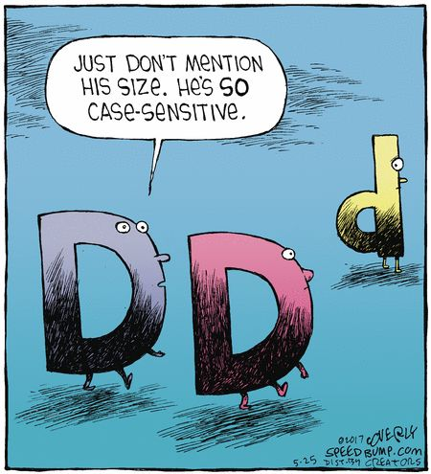
Problem 1 – Case Sensitivity
Fabric data warehouses are case sensitive by default which can lead to errors
Solution – utilize the API to create a case-insensitive warehouse.
Important note – you cannot convert a warehouse to be case-insensitive. You must create a new one and port data over to it if necessary.
Notes:
SHOW HOW TO SET UP SERVER REGISTRATIONS IN SSMS

Slide 11

Demo Time!

Slide 12

Problem 2 – Performance Monitoring
Built-in performance monitoring leverage DMVs that can be slow running and fail when capacity is overloaded
Solution – utilize DMVs to build a warehouse monitoring tool that imports data that will still work when capacity is slowing down.
Important note – this solution is best suited to live in a separate capacity (can even be a pro or PPU workspace) so that it doesn’t slow when the capacity gets throttled
Notes:
DMV = dynamic management view

Slide 13
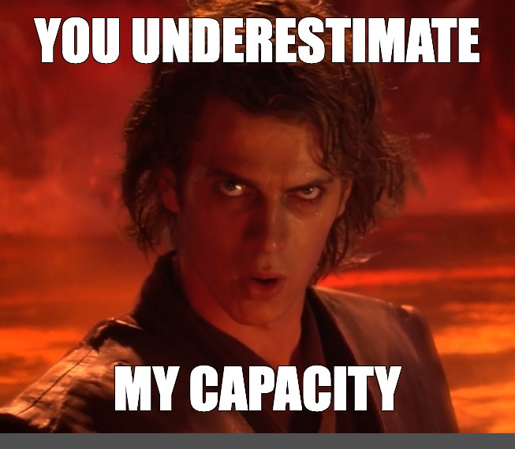
Problem 3 – Killing those Capacity Murderers
Rogue queries can consume excessive resources, potentially crippling warehouse capacity. Unfortunately, the capacity metric app does not contain session IDs necessary to kill long running queries.
Solution – utilize custom monitoring to find session IDs to kill when needed.
Important note – this solution is best suited to live in a separate capacity (can even be a pro or PPU workspace) so that it doesn’t slow when the capacity gets throttled
Notes:
Permissions
An Admin has permissions to execute all three DMVs (sys.dm_exec_connections, sys.dm_exec_sessions, sys.dm_exec_requests) to see their own and others' information within a workspace.
A Member, Contributor, and Viewer can execute sys.dm_exec_sessions and sys.dm_exec_requests and see their own results within the warehouse, but does not have permission to execute sys.dm_exec_connections.
Only an Admin has permission to run the KILL command.

Slide 14


Slide 15

Don’t forget to connect, thanks for listening!
https://dataonwheels.wordpress.com/
kristyna@dataonwheels.com
@data_dragoness
GitHub

Slide 16



Please complete you session evaluations
https://www.sqlsatbr.com/session-evaluations

